Slide 1
ROBOTIC PERCEPTION AND ACTION PROJECT
EMG signal classification using deep learning algorithms

Slide 2

introduction emg signals and movements

Slide 3
data processing

Slide 4
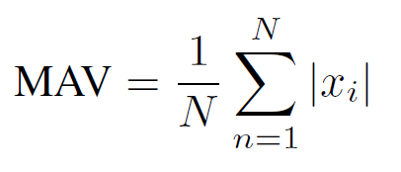
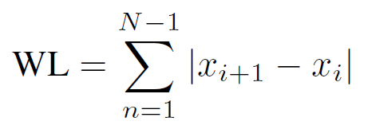
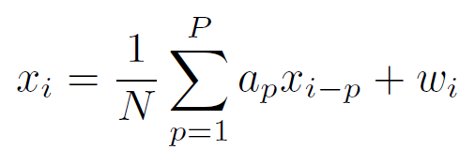
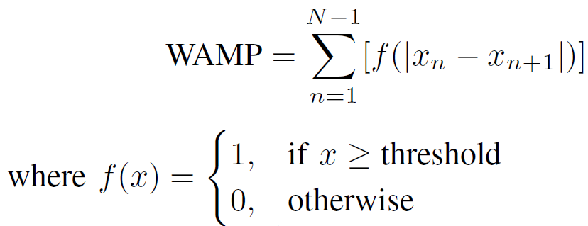
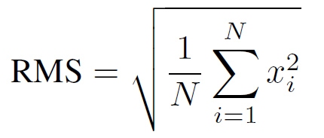
FEATURES
Manual feature extraction:
Signal divided in segments of equal length
Set of feature values put in a row vector

Slide 5
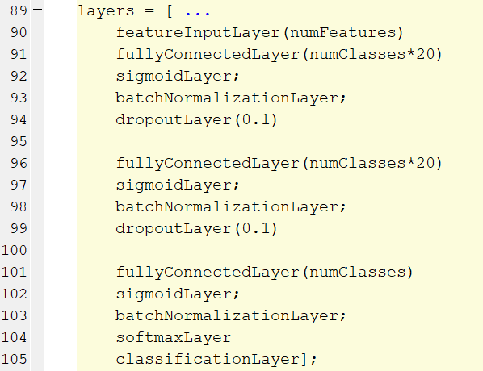
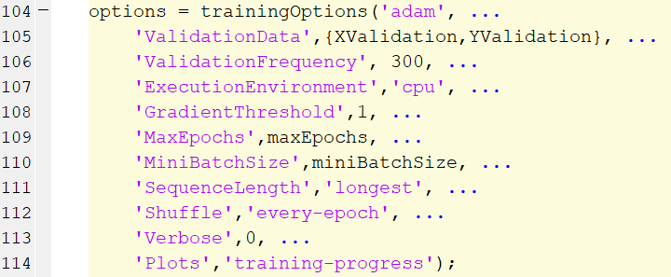

DNN Structure
80% training and 20% testing

Slide 6
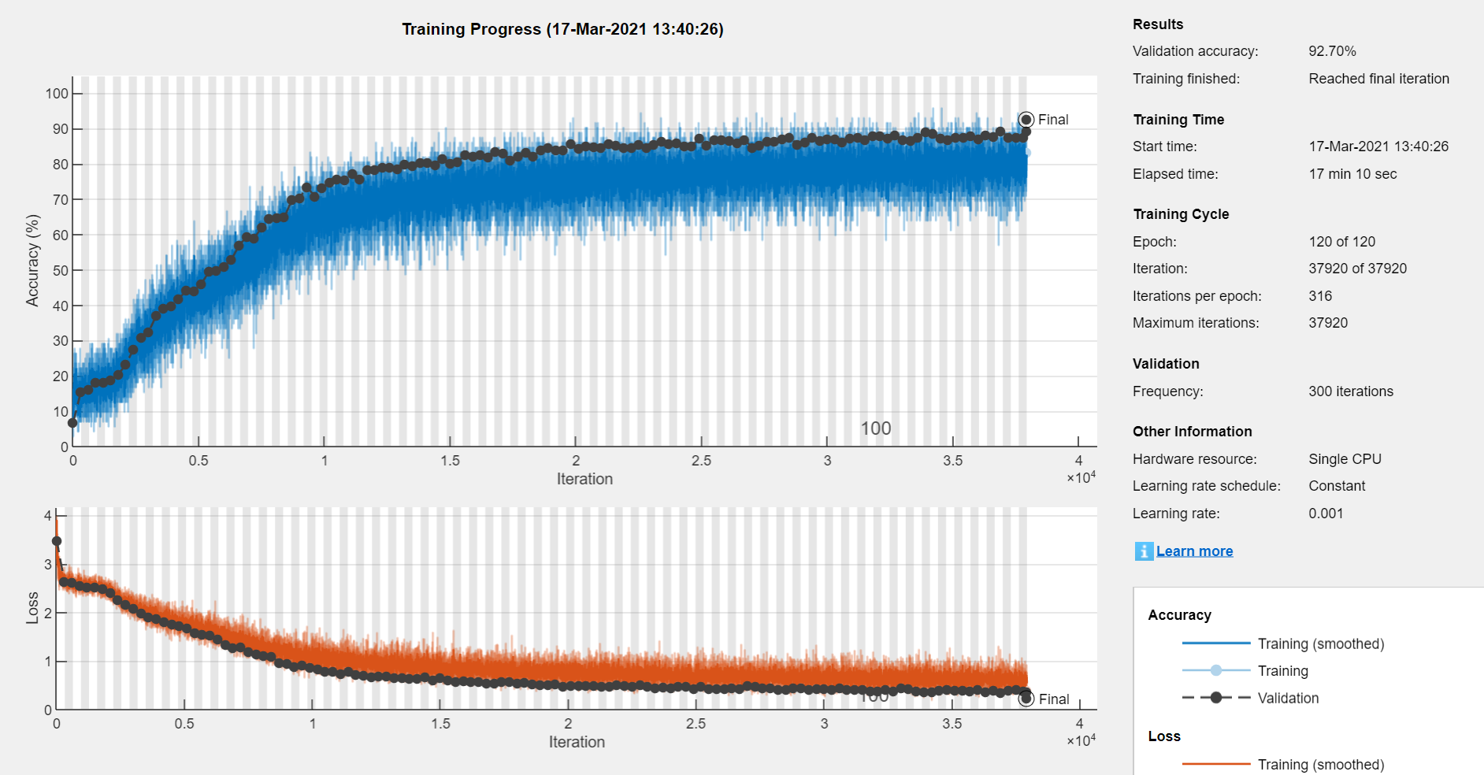
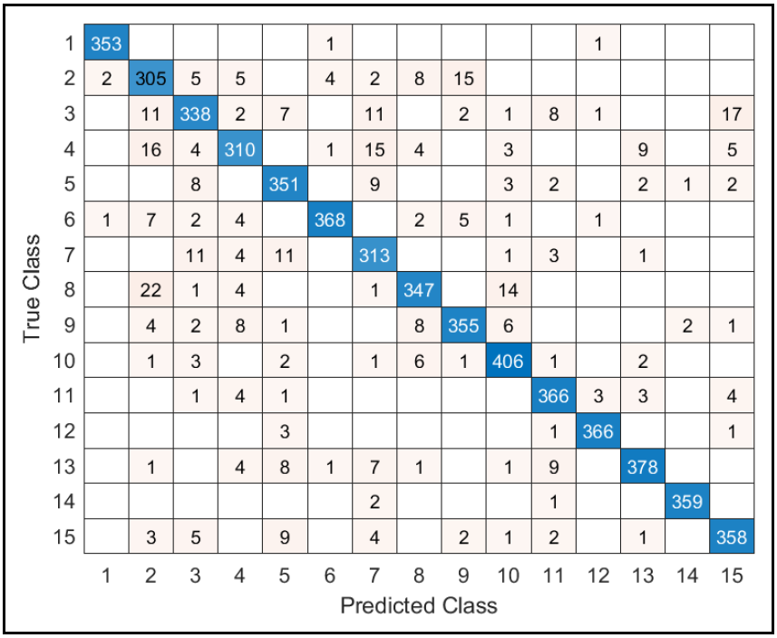
DNN Accuracy
92.7%

Slide 7
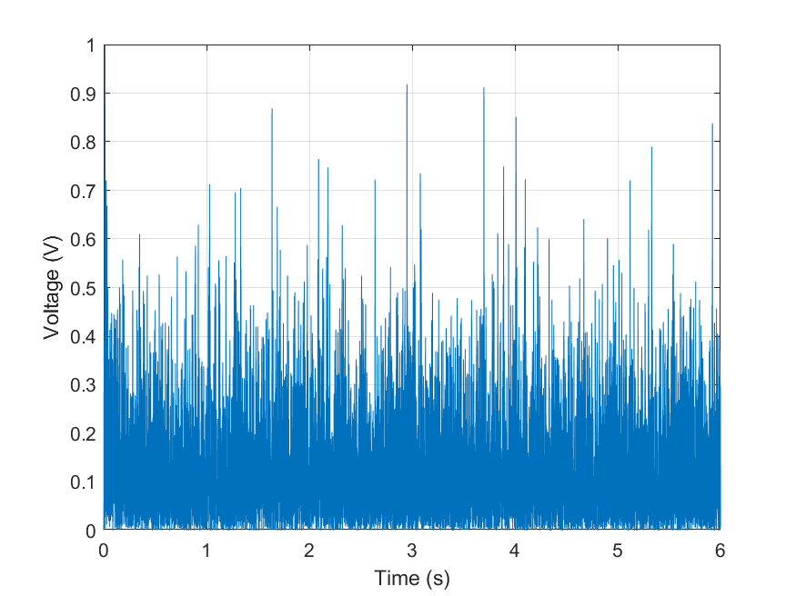
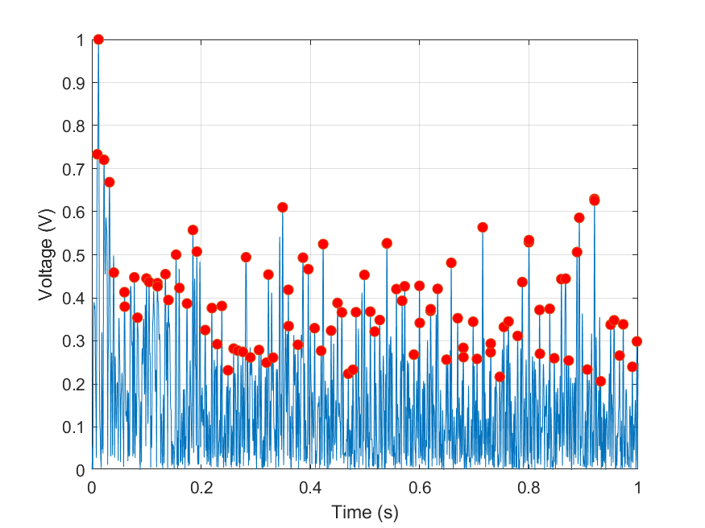
LSTM compression
Sliding window of 1 second
Compression to 100 values

Slide 8
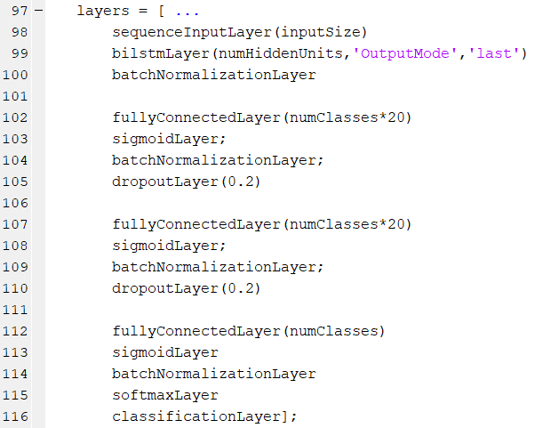
LSTM Structure

Slide 9
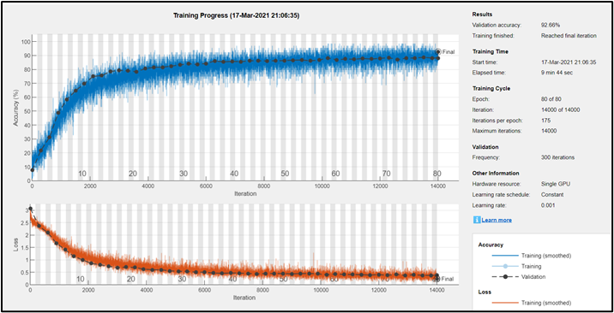
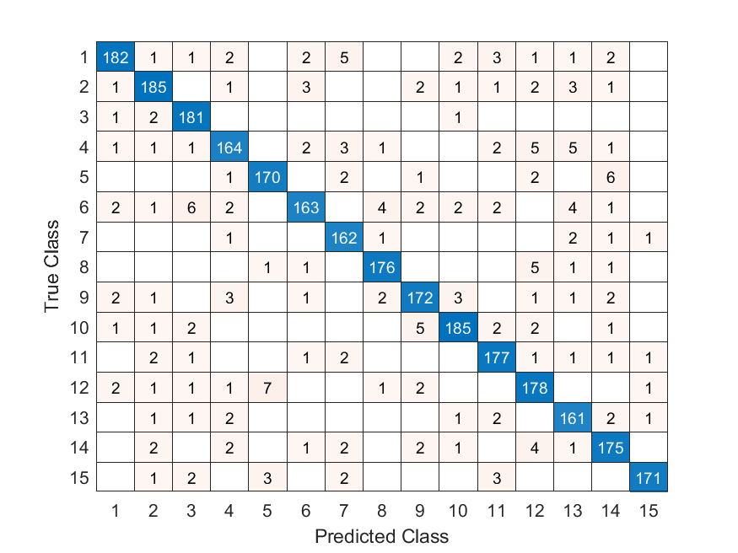
LSTM Accuracy

Slide 10
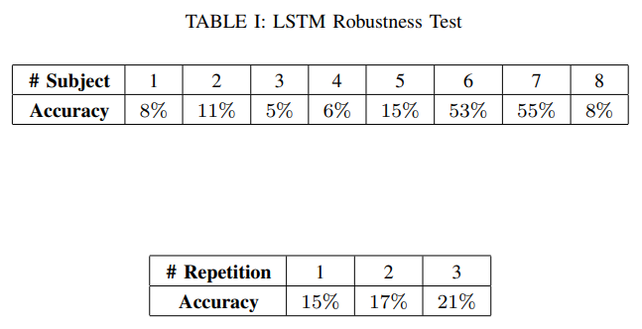
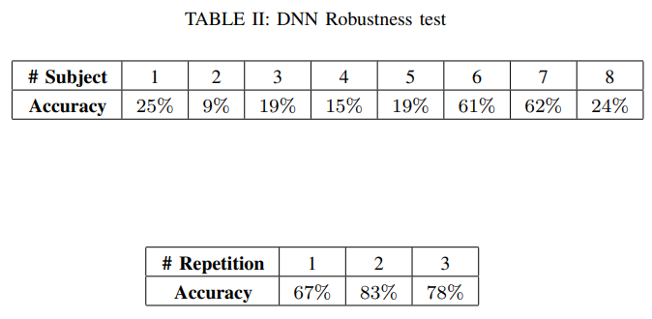
Robustness

Slide 11
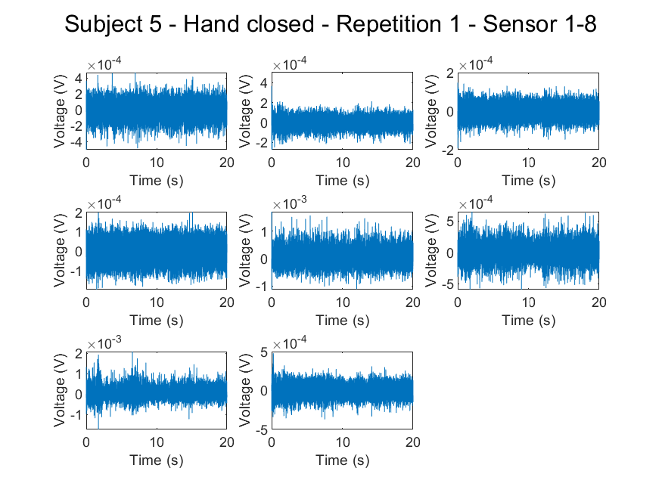
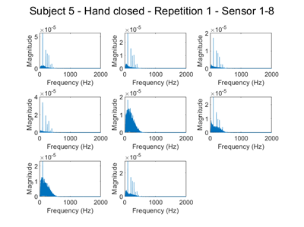
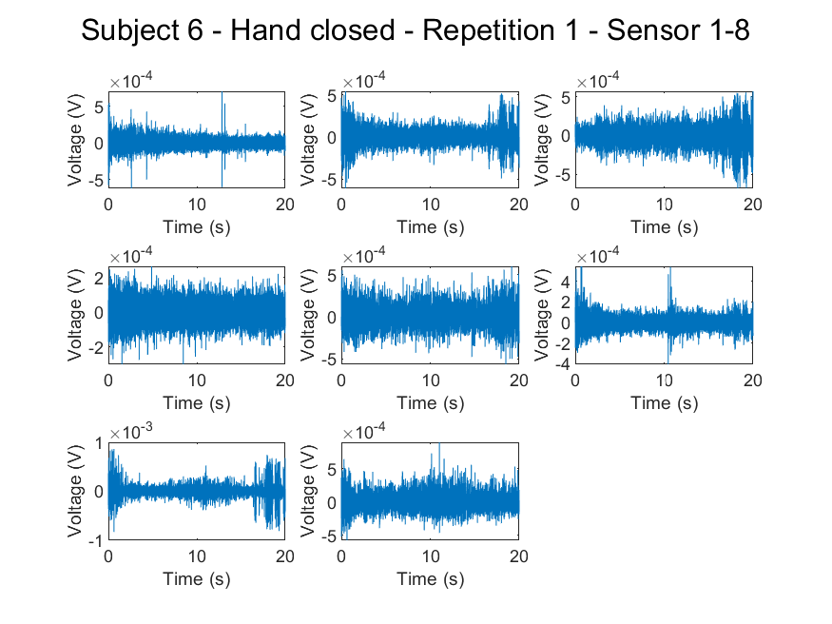
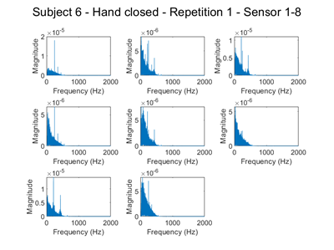
Robustness
Time signals
FFT

Slide 12
Conclusions and future developments
Both networks reached a final accuracy above 90%
Weak robustness to new subjects
Weak robustness to repetitions (LSTM)
Increase the number of features (DNN)
Increase the dataset (more subjects/repetitions)
Augment the dataset

Slide 13
THANKS FOR THE ATTENTION

